Slide 1
Cloud Prototyping SS19
Decentralized Energy Trading
Midterm Presentation

Slide 2

Table of Content
Motivation
Architecture
Current implementation
Blockchain
Household processing unit
Utility contract
Live demo
Following

Slide 3




Motivation
EEG Umlage
Notes:
Current Status with EEG Umlage

Slide 4
Motivation
EEG Umlage
Notes:
In 202x Elimination of EEG Umlage

Slide 5

Motivation
Notes:
Prosumer has no use for solar panels anymore

Slide 6

Motivation
Notes:
Solution: Ethereum Blockchain

Slide 7
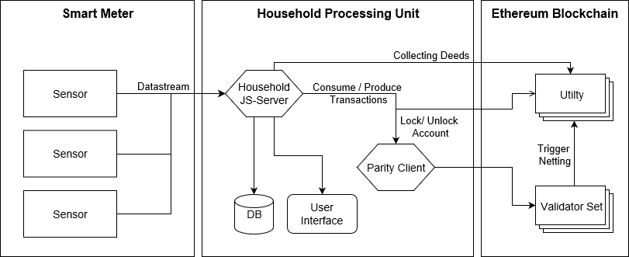
Architecture

Slide 8
Architecture
Collecting Deeds
Data
Stream
Household JS-Server
Utility
Sensor
Consume/Produce
Transactions
Lock/Unlock
Account
Sensor
Parity Client
Trigger Netting
Sensor
Validator Set
Database
User Interface
Smart Meter
Household Processing Unit
Ethereum Blockchain
Notes:
Question: Too overloaded? Thinking about getting rid of the arrow descriptions.
Maybe split this into 2 slides with descriptions then: 1. Smart Meter & HS Processing Unit 2. HS Processing Unit & Blockchain
Also thinking about renaming Utility as it sounds like the Energy provider is involved into this

Slide 9
Current implementation

Slide 10
Blockchain
Ethereum Proof of Authority Blockchain
Built on Parity
Smart Contracts
Validator Set
Settle

Slide 11
Household processing Unit
Collecting Deeds
NodeJS Server with Express.js
MongoDB
Sensors Data
Blockchain Data
User Interface
Displaying Data
Parity Client
Access to Blockchain
Household JS-Server
Consume/Produce
Transactions
Data
Stream
Lock/Unlock
Account
Parity Client
Database
User Interface
Household Processing Unit
Notes:
Not sure if displaying the HHUnit is good here. Looks too crowded.

Slide 12
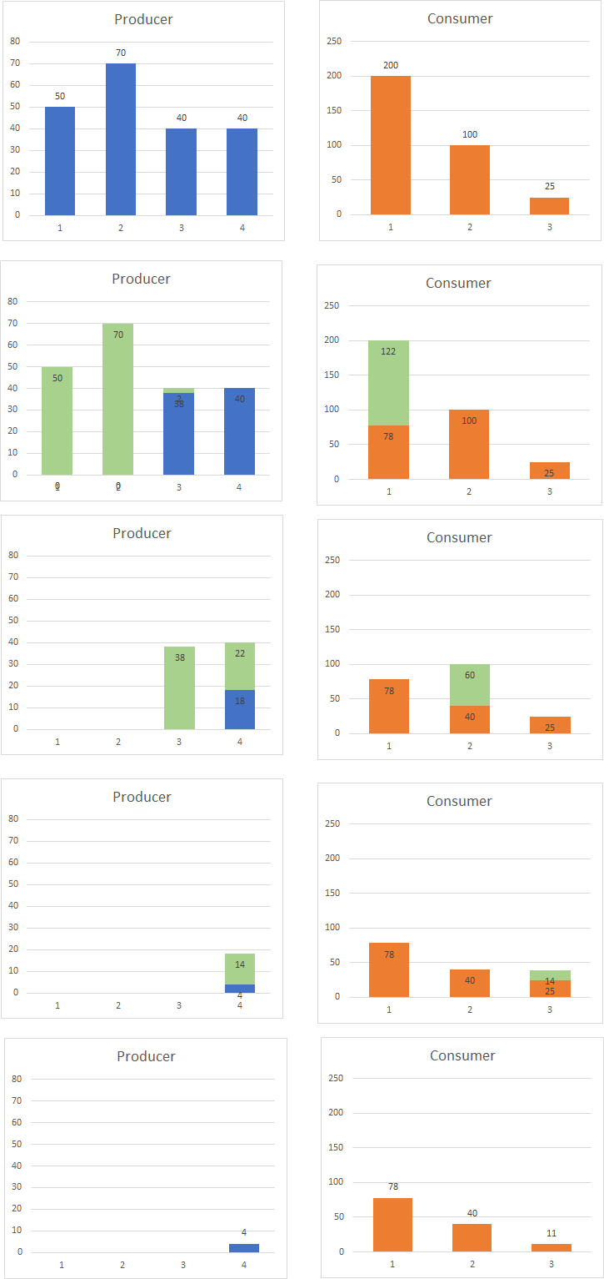
Settlement Algorithm
Notes:
TODO: Explain Settlement with picture overlay

Slide 13
Live Demo

Slide 14
Following

